Slide 1
Learning from Data: Decision Trees
Notes:
This module is the beginning of our discussion on learning from data. The discussion, comprising several modules, culminates in a discussion of neural, starting with unsupervised learning.

Slide 2
Learning and Intro to Neural Nets
Decision Trees
Support Vector Machines
K-means Learning
Neural Nets
Architectures
Unsupervised learning
Supervised learning
Notes:
There are many things that we can learn from data. Neural nets are the most common technique as of this writing but they produce “black boxes.” We’ll precede our neural net discussion with some techniques that produce understandable extractions. The first is to construct a decision tree from data.

Slide 3
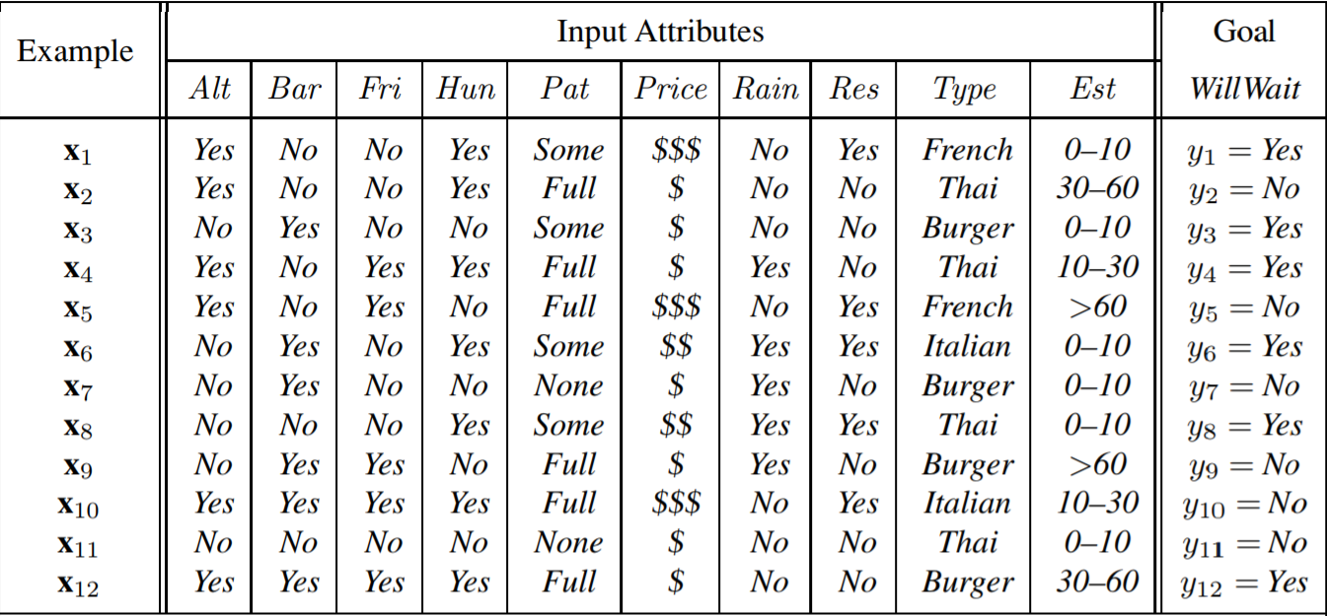
Give Data*
Russel & Norvig p 700
Notes:
Here is an example from Russel and Norvig’s book* regarding whether or not to wait at a restaurant for a table. Suppose that we have data about waiting from other restaurant patrons, as shown. We’d like the data and machine learning to produce an efficient decision tree.
In other words, we would like to learn an algorithm from this data.

Slide 4
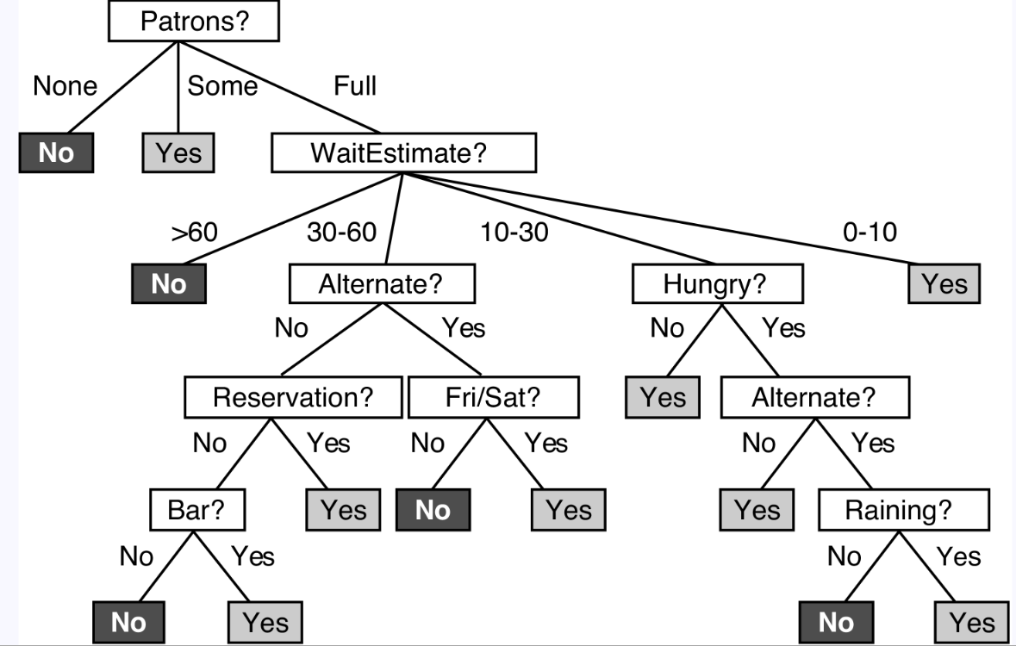
Decision Tree Example: Wait for a Table?
Source: Russell & Norvig
Notes:
There are many possibilities for the decision tree. The figure shows one. But how can we make on?
* Artificial Intelligence: A Modern Approach

Slide 5
Decision Tree Example: Wait for a Table?
Create from data
Greedy approach: check first the most discriminatory remaining criterion
Source: Russell & Norvig
Notes:
A common approach (actually, a “greedy” one) is as follows. Its advantage is speed of execution by asking the most important questions first.
The learning algorithm examines each type of data—such as the estimated wait time—and identifies the one that comes closest to splitting the patrons in half. In the example of the figure, this turns out to be the question “are there currently patrons in the restaurant?” For example, 33% of the records involved no patrons present and the decision not to stay (fearing its unpopularity), 33% involved records with some patrons (but not full) and the decision to stay, and 34% neither of these; and furthermore, no other criterion comes closer to evenly dividing the records. Thus, in this case, Patrons present? Is made the root decision tree node. The remaining tree is built in the same way (i.e., recursively), except that the ancestral assumptions are assumed. For example, every expansion below WaitEstimate? is made using only those records with Patrons = Full.
Decision trees may be appropriate but they are black-and-white, which is not always appropriate. For example, suppose that a doctor is trying diagnose a patient based on 100 lab data. A decision tree could indeed be constructed but we would be loath to trust it because it may not be appropriate to see the world as black or white.

Slide 6
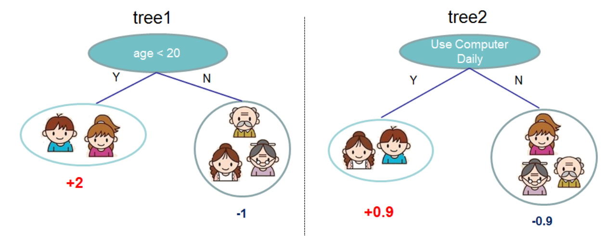
Boosted Trees with TensorFlow
https://xgboost.readthedocs.io/en/latest/tutorials/model.html

